Slide 1
Random Access Procedure in MAC Group 3 Specification 38.321 Mentored by:-Abhijeet sir
Role: Manages initial connection establishment and channel access. Significance: Ensures efficient and fair access to the communication channel.

Slide 2
Presented By:-
Bhakti S
Ranjita Karadad
Ritesh Mishra
Vaidehi Shailendra Bhosale
Vanaja Dukka
Vivek Kumar
Yash Pramod Gulhane
Yengala Dharmendra Kumar Reddy

Slide 3
Contents
Introduction to MAC Layer
Overview of Random Access Procedure
Random Access call flow
Role of Random Access Procedure in MAC
Significance of Random Access Procedure
Type of Random Access Procedures
Key Challenges and solutions
Real-World Applications
Code
Conclusion

Slide 4
Introduction to MAC layer
The MAC(Medium Access Control) layer is a crucial part of wireless communication systems, play a important role in 5G wireless communication.
It helps in managing how transmitting and receiving the data over the air between the UE(like a mobile phone) and network.
MAC layer is lowest layer of Layer 2. It present between the RLC and Physical layer.
The Medium Access Control (MAC) layer is responsible for managing protocol access to the physical network medium.
Function of MAC layer like
-Mapping between logical channels and physical channels
- Multiplexing of MAC SDUs

Slide 5
-DE multiplexing of MAC SDUs
-Error correction through HARQ
-Random Access Control
The MAC layer is like a manager that:-
- Keeps devices from talking over each other
- Assigns resources to devices
- Prioritizes important data
- Ensures data is delivered correctly
- Supports different types of services
Importance of MAC Layer are:-
-Low Latency
-High speed Data Transmission
-QoS(Quality of Service
-Security
-Ultra-Reliable Communication

Slide 6
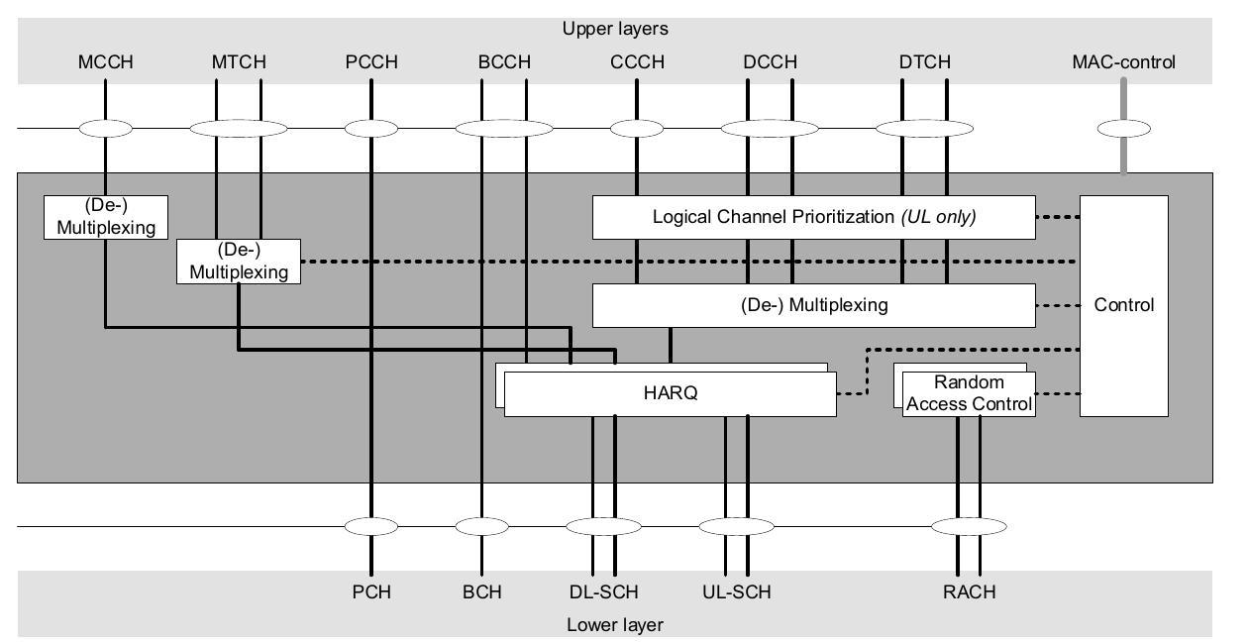
Diagram of MAC Layer

Slide 7
Overview of Random Access Procedure
The Random Access Procedure is a method used by device (UE) to initiate communication with the network, especially when they need to connect to network for the first time or re-establish a connection.
It’s a critical component of the 5G NR (New Radio) protocol.
RAP is like a "doorbell" that devices ring to access the 5G network. The network responds, and they establish a secure connection.
Random Access Procedure (RAP) in 5G is a process that allows devices to:
-Access the network for the first time
-Re-establish a connection after a disruption
-Handover to a new cell

Slide 8
Random Access call flow
Random Access Procedure call flow in 5G:-
Device Request:-
-Action: A device (User Equipment or UE) wants to connect or send data.
-Process: The device picks a random time and sends a “Random Access Preamble” to the network.
2. Network Response:-
-Action: The base station (gNB) receives the device’s preamble.
Process: The network responds with a “Random Access Response” that includes timing adjustments and resource allocation details.
3. Device Confirmation:-
-Action: The device receives the network’s response.

Slide 9
Action: The base station processes the connection request.
-Process: The device then sends a “Connection Request” message to the base station, providing its identity and other information.
4. Network Acknowledgment:-
-Action: The base station processes the connection request.
-Process: The network sends a “Connection Accept” message back to the device, confirming that the connection is established.
5. Connection Setup:-
-Action: The device and network finalize the connection details.
-Process: Further instructions and resources are allocated for communication between the device and the network.

Slide 10
Role of Random access Procedure in MAC
Connection Establishment:- The random access procedure facilitates the initial connection establishment between devices, enabling them to communicate with each other.
Channel Access management:-The RAP determines which device has the right to transmit data at a given time, preventing collisions and ensuring efficient channel utilization.
Data Transmission:- It handles the transmission of data frames between devices, ensuring reliable delivery and proper acknowledgment.
Time synchronization:-Establishes timing synchronization between device and network.
Handle Network Load:- It helps manger network load by allowing device to access the network in a control manner and it ensure that device can connect even when the network is busy.

Slide 11
Significance of Random Access Procedure
The RAP's significance lies in its ability to ensure efficient and fair access to the shared communication channel. This prevents collisions, minimizes delays, and optimizes network performance.
Collision Avoidance:-The RAP utilizes mechanisms to prevent multiple devices from transmitting simultaneously, leading to signal interference and data loss.
Fairness and Efficiency:-The RAP promotes fair access by allowing devices to take turns, preventing any single device from monopolizing the channel.
Improve Network Throughput:-By minimizing collisions and maximizing channel utilization, the RAP contributes to a higher overall data transmission rate.
Reliability:- Ensures reliable connection establishment, critical for mission-critical applications.
Low Latency:- Helps reduce latency, enabling fast and reliable communication.

Slide 12
Type of Random Access Procedures
Random Access Procedures are two types
CBRA(Contention-Based Random Access ):-
- Devices compete for network access using a random preamble
- Multiple devices can transmit the same preamble, leading to collisions
- Network resolves collisions using a contention resolution process
- Used for:
Initial access
Handover
Connection re-establishment

Slide 13
Type
2. CFRA(Contention-Free Random Access):-
- Network allocates a dedicated preamble to a device
- No competition or collisions occur
- Used for:
Scheduling requests
Buffer status reports
Other signalling procedures
Subcategories:
4-step RA type with MSG1
2-step RA type with MSGA:
Contention-Based Random Access is used for initial access and connection establishment, where devices compete for network access, while Contention-Free Random Access is used for scheduling and signalling procedures, where devices are allocated a dedicated preamble to avoid collisions.

Slide 14
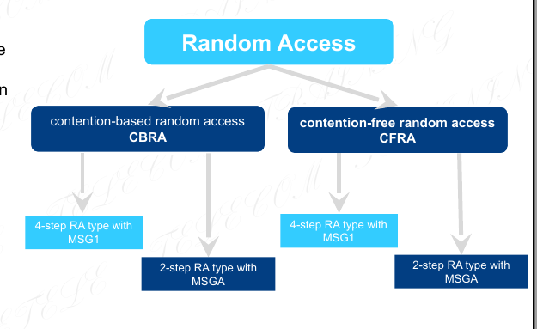

Slide 15
Key Challenges and solutions
Challenges-
High Traffic and Congestion:- Large number of devices accessing the network simultaneously.
Low latency Requirements:-5G's ultra-low latency requirements make RAP delays critical.
Security Threats:- Warning: -Vulnerable to cyber attacks and unauthorized access.
Scalability:- Handling the increasing network traffic and growing number of devices.
Interface Management:- Managing interference from multiple devices accessing the network.

Slide 16
Key Challenges and solutions
Solutions:-
Enhanced Contention Resolution Algorithms:- Improving collision resolution to reduce delays.
Dedicated RAP Channels: Allocating separate channels for RAP to reduce congestion.
Security Enhancements: Implementing advanced security measures, such as encryption and authentication.
RAP Optimization: Optimizing RAP parameters, such as preamble selection and transmission power.
Edge Computing: Processing RAP at the edge to reduce latency and improve performance.

Slide 17
Real-World Applications
Smart Cities: RAP supports smart city applications, like intelligent transportation systems, smart energy management, and public safety.
Autonomous Vehicles: RAP enables vehicle-to-everything (V2X) communications, critical for autonomous vehicles' safety and navigation.
Public Safety: RAP enables mission-critical communications for public safety agencies, such as police, fire, and ambulance services.
Smart Homes: RAP enables smart home applications, such as home automation, security systems, and voice assistants.
Cellular Networks: RAP is used in cellular networks for initial access, handover, and connection re-establishment.
Public Wi-FI and Hotspot:-When we connect to a public Wi-FI network or hotspot,the RAP helps your device get a connection quickely, even in crowed area with many other users.

Slide 18
Code

Slide 19

Conclusion
Efficient Access:- Random access procedures are essential for efficient and fair access to shared communication channels.
Improve Performance:- They contribute to improved network performance, enabling faster data transfer and reduced latency.
Key for Modern Network:- Random access procedures are crucial for the operation of modern wireless and wired networks.

Slide 20
Thank you

